Slide 1
Intelligence Testing

Slide 2
What is Intelligence?
Learn from experiences, adapt to new situations, solve problems, think critically
How to operationalize?
Notes:
What is intelligence?

Slide 3
CLASSIFYING INTELLIGENCE
Historically many ways to define intelligence.
Charles Spearman
Believed intelligence consisted of one general factor, called g.
Focused on commonalities amongst various intellectual abilities.
Raymond Cattell
Divided intelligence into two components.
Crystalized intelligence – acquired knowledge and the ability to retrieve it.
Knowing facts.
Fluid intelligence – the ability to see complex relationships and solve problems.
Knowing how to do something.
Notes:
What is intelligence?

Slide 4
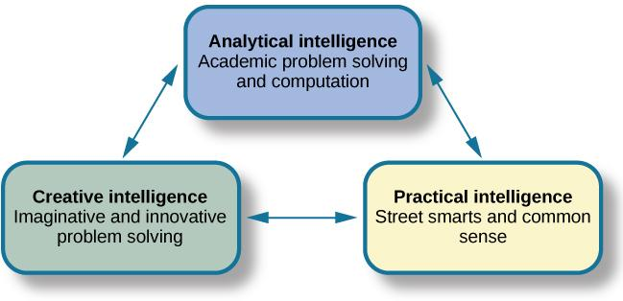
TRIARCHIC THEORY OF INTELLIGENCE
Robert Sternberg’s theory identifies three types of intelligence: practical, creative, and analytical.

Slide 5
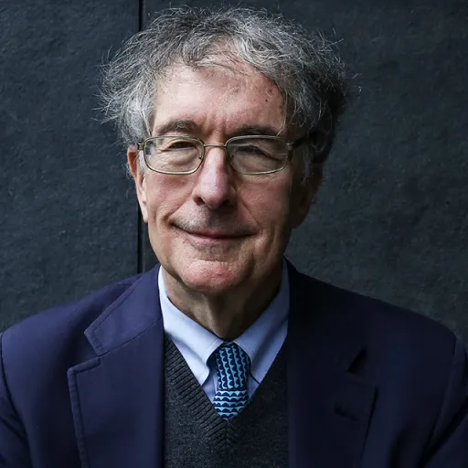
Multiple Intelligence Theory (1)
Howard Gardner
Multiple intelligence theory: eight independent kinds of intelligence.
Intelligence is biologically based and has own developmental pattern.
Notes:
D. Multiple Intelligences
a. Multiple intelligence theory: Gardner’s theory that proposes at least eight independent kinds of intelligence and expands the use of the term intelligence to refer to skills not usually considered intelligence by experts and has led to a great deal of debate among intelligence theorists and researchers
b. Each person and type of intelligence is biologically based and has its own unique developmental pattern

Slide 6
Multiple Intelligence Theory
Gardner rejects IQ score as a measure of human intelligence
Argues for eight intelligences:
  Linguistic intelligence
  Logical-mathematical intelligence
  Spatial intelligence
  Musical intelligence
  Bodily-kinesthetic intelligence
  Interpersonal /Intrapersonal intelligence
  Naturalist intelligence
  Existential intelligence

Slide 7
MEASURES OF INTELLIGENCE (1)
Measuring intelligence can come in many forms.
A person’s Intelligence quotient (IQ) is a score earned on a test designed to measure intelligence.
How do psychologists ensure that tests function as valid measures of intelligence?

Slide 8
MEASURES OF INTELLIGENCE (2)
The Stanford-Binet Intelligence Scale
Early 1900’s – Alfred Binet developed an intelligence test to use on children to determine which ones might have difficulty in school.
Louis Terman (a Stanford psychologist) modified Binet’s work by standardizing the administration of the test and testing thousands of children to establish a norm.
Standardization – the manner of administration, scoring, and interpretation of results is consistent.
Norming – giving a test to a large population so data can be collected comparing groups, such as age groups.
The resulting data provide norms/referential scores used to interpret future scores.
Standardization and norming ensure that new scores are reliable.

Slide 9
The Psychometric or Testing Approach (1)
Cattell-Horn-Carroll theory: Intelligence is a hierarchy
  Top general ability factor
  Broad dimensions of abilities: fluid intelligence, crystallized intelligence, memory capacity, and processing speed
    Factor analysis: statistical technique in which test items are correlated to identify groups of items that correlate highly with each other but not with other groups of items
  Bottom: Specific skills
Notes:
\

Slide 10
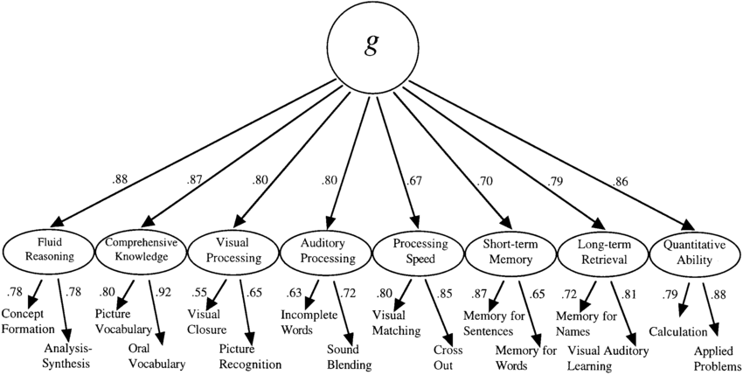
General Intelligence

Slide 11
The Psychometric or Testing Approach (2)
Stanford-Binet Test
  Mental age: child’s performance relative to same age children.
  Intelligence quotient (IQ): mental age (MA) divided by chronological age (CA), multiplied by 100.
  Stanford-Binet 5: today’s Stanford-Binet Intelligence Scales that measure intelligence as five abilities.
    Fluid
    Knowledge,
    Quantitative
    Visual-Spatial
    Working Memory
Notes:
Today’s test compares to norms, not mental age
1905: Alfred Binet and his student, Theodore Simon, published Binet-Simon test, which assessed children’s ability to reason verbally and numerically, solve problems, and think logically
b. Mental Age
i. Mental age: a child’s performance relative to same age children, as defined by Binet
ii. Most children’s mental age corresponds to their chronological age
iii. Children whose mental age is greater than their chronological age have a high level of intelligence
iv. Children whose mental age is less than their chronological age have a low level of intelligence
c. Intelligence Quotient
i. Intelligence quotient: a score defined as mental age (MA) divided by chronological age (CA), multiplied by 100 (IQ = MA/CA × 100)
ii. IQ score of 100 indicates average intelligence, regardless of a child’s age, because it shows the child can correctly answer the same items as same-age peers
d. Stanford-Binet 5
i. Stanford-Binet 5: today’s Stanford-Binet Intelligence Scales that measures intelligence as five intellectual abilities that are assessed with verbal and nonverbal tasks:
1. Knowledge
2. Quantitative reasoning
3. Visual-spatial processing
4. Working memory
5. Fluid reasoning
ii. No longer uses the concept of mental age
iii. IQ scores now reflect individuals’ performance compared with test norms (standards of performance based on average scores)

Slide 12
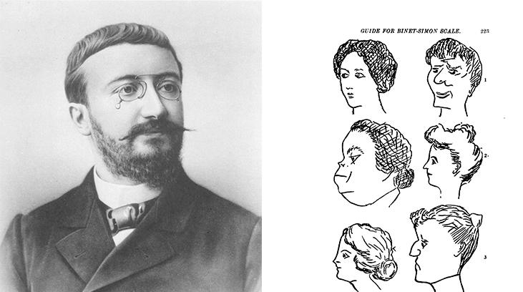
ALFRED BINET
Alfred Binet
Notes:
French psychologist Alfred Binet helped to develop intelligence testing. (b) This page is from a 1908 version of the Binet-Simon Intelligence Scale. Children being tested were asked which face, of each pair, was prettier

Slide 13
The Psychometric or Testing Approach (3)
Wechsler Adult Intelligence Scale (WAIS)
David Wechsler’s definition of intelligence - ”the global capacity of a person to act purposefully, to think rationally, and to deal effectively with his environment.”
In 1939, Wechsler developed a new IQ test by combining several subtests from other intelligence tests.
Tapped into a variety of verbal and nonverbal skills.
One of the most extensively used intelligence tests.
Wechsler Intelligence Scale for Children (WISC-V) is one of many versions used today that tests 1) verbal comprehension, 2) visual spatial, 3) fluid reasoning, 4) working memory and 5) processing Speed.

Slide 14
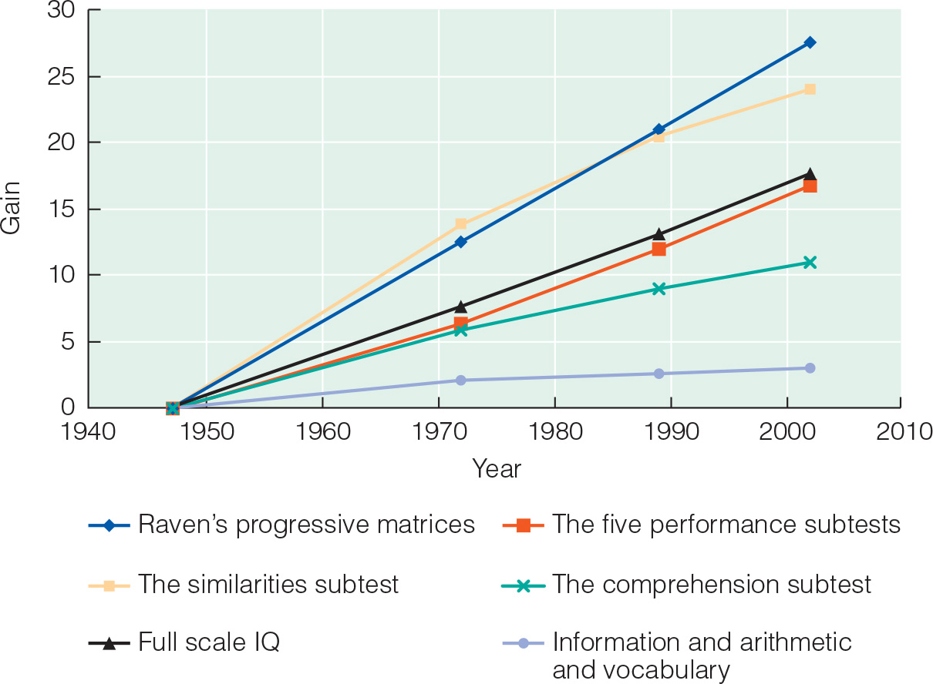
The Flynn Effect
After years of use within schools and communities, periodic recalibration of WAIS lead to an observation known as the Flynn effect.
The observation that each generation has a significantly higher IQ than the last.

Slide 15
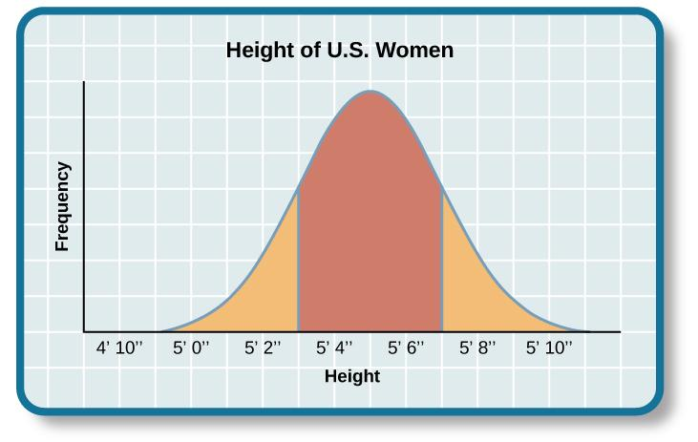
THE BELL CURVE
Results of intelligence tests follow the bell curve.
In psychological testing, this graph demonstrates a representative sample/normal distribution of a trait in the human population.
Representative sample – a subset of the population that accurately represents the general population.
Usually requires a large sample size.

Slide 16
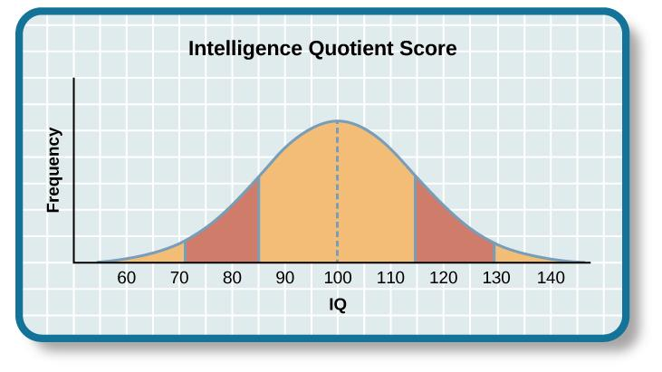
IQ BELL CURVE
The average IQ score is 100.
Standard deviations – describe how data are dispersed in a population.
One standard deviation in IQ testing is 15 points.
A score of 85 is one standard deviation below the mean (average).
Any score between one standard deviation above and below the mean is considered and average.
82% of the population have an IQ score between 85 and 115.

Slide 17
Extremes of Intelligence
Intellectual disability
  Have significantly below-average intellectual functioning (score of 70 or below on an IQ test)
Gifted
  Have an IQ score of 130 or higher or they show special abilities in areas valued by society

Slide 18
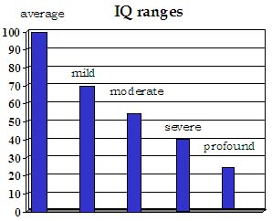
INTELLECTUAL DISABILITY
2.2% of the population has an IQ score below 70 and are considered intellectually disabled.
Exhibit deficits in intellectual functioning and adaptive behavior.
Formerly known as mental retardation.
The 4 subtypes are mild, moderate, severe and profound.
(Credit: National Institute of Health)

Slide 19
The Psychometric or Testing Approach (4)
Correlates of IQ
Academic achievement, educational attainment, occupational status, unemployment, income, and health and longevity.
Is IQ really measuring intelligence?
Notes:
LO 8-1: Describe intelligence, intelligence tests, and correlates of IQ.
D. Weschler Tests
a. Weschler tests—a set of widely used measures of intelligence constructed by David Wechsler, who viewed intelligence as “the global capacity of a person to act purposefully, to think rationally, and to deal effectively with his environment”
b. Children’s’ test = Wechsler Intelligence Scale for Children (WISC-V)
i. Composed of 10 subtests and 5 indexes: verbal comprehension, visual spatial, fluid reasoning, working memory, and processing speed
ii. Tests verbal and nonverbal abilities
iii. Score of 100 is average for a person’s age
iv. Standardized on samples of children that represent the total population of a country’s population
E. Correlates of IQ
a. Childhood academic achievement
b. Educational attainment
c. Occupational status
d Unemployment
e. Income
f. Health and longevity

